Slide 1

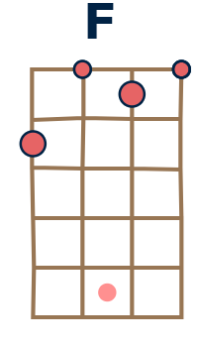
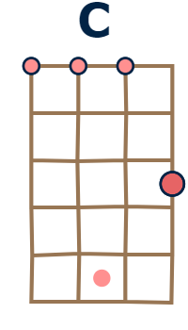
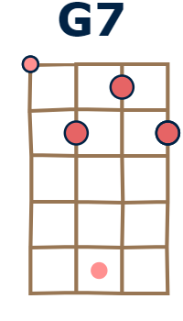
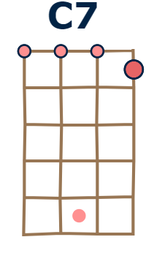
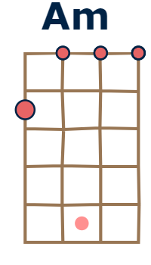

Tonalité : C - 106 BPM
This land is your land
by Woody Guthrie ( 1940 )
Chorus :
  F C
  This land is your land, and this land is my land
  G7 C C7
  From California to the New York island
  F C Am
  From the Redwood Forest to the Gulf Stream waters
  G7 C C7
  This land was made for you and me
F C
As I went walking that ribbon of highway
G7 C C7
And I saw above me that endless skyway
F C Am
I saw below me that golden valley
G7 C C7
This land was made for you and me
F C
I roamed and rambled, and I've followed my footsteps
G7 C C7
To the sparkling sands of her diamond deserts
F C Am
All around me, a voice was sounding
G7 C C7
This land was made for you and me
Chorus

